Slide 1


Augmented Reality - Revolutionizing Retail and E-commerce
Augmented reality (AR) is rapidly transforming the way consumers shop, both in-store and online. By overlaying digital content onto the physical world, AR allows shoppers to virtually preview products, visualize them in their own space, and enjoy more immersive, engaging shopping journeys.

Slide 2
What is Augmented Reality?
Augmented reality (AR) is a technology that overlays digital information onto the real world, creating an interactive and immersive experience for users. AR blends the physical and digital worlds by adding computer-generated images, sounds, and other sensory information to a user's perception of reality. This can be achieved through devices such as smartphones, tablets, and smart glasses, which use cameras and sensors to interpret the user's environment and overlay relevant digital content.

Slide 3
How Does Augmented Reality Work?
Blending Digital & Physical
Tracking & Mapping
Real-Time Rendering
Augmented reality overlays digital content onto the real world, seamlessly integrating virtual elements with the user's surroundings.
AR uses cameras, sensors, and location data to track the user's environment and precisely position virtual objects within it.
Advanced rendering engines power the instantaneous display of 3D models, animations, and interactive experiences in AR.

Slide 4
The Rise of AR in the Digital Age
Digital Transformation
Mobile Dominance
Emerging Technologies
Consumer Adoption
Smartphones and tablets equipped with AR capabilities have put immersive experiences in the hands of billions of consumers.
Increasing user familiarity and demand for AR-enhanced applications are fueling widespread adoption across industries.
Augmented reality is at the forefront of the digital revolution, seamlessly blending the physical and virtual worlds.
Advancements in computer vision, machine learning, and real-time rendering are driving the rapid evolution of AR.

Slide 5
Enhancing the Shopping Experience
Virtual Product Previews
Interactive Showrooms
Immersive Storytelling
Shoppers can visualize products in their own space before making a purchase, reducing returns and increasing customer satisfaction.
AR-powered showrooms allow customers to interact with 3D product models, explore features, and customize items in real-time.
Brands can use AR to create captivating, interactive experiences that deepen emotional connections with consumers.

Slide 6

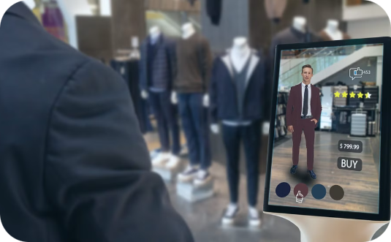

Virtual Product Visualization
Visualize Products in Context
Try on Products Virtually
Customize Products in Real-Time
AR allows shoppers to see how products will look and fit in their own living spaces before purchasing.
Consumers can use AR to virtually "try on" items like clothing, accessories, and cosmetics.
AR empowers shoppers to customize products and see the changes instantly, enhancing the shopping experience.

Slide 7

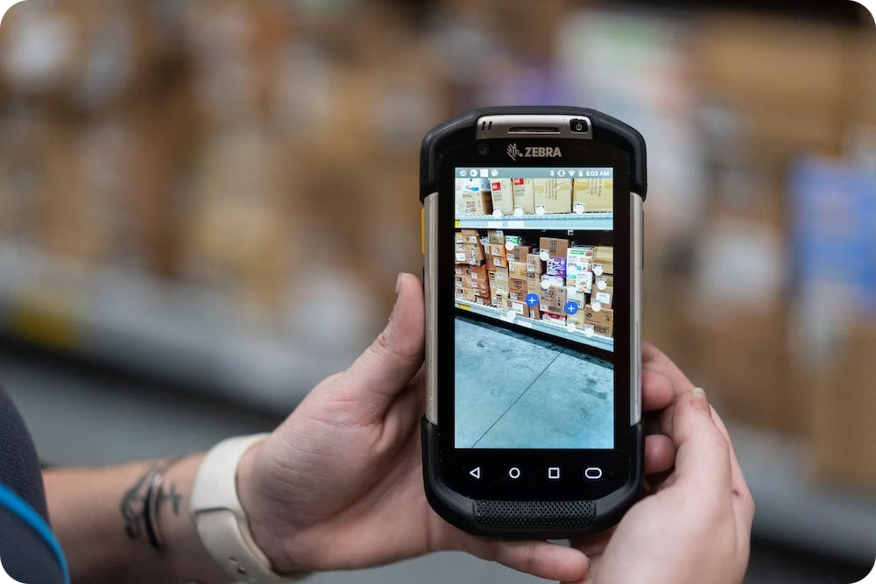
Immersive Brand Storytelling
Interactive Product Demos
Captivating Installations
AR allows brands to bring their products to life, giving consumers an immersive, hands-on experience that drives deeper engagement.
Innovative AR-powered installations create memorable, shareable brand experiences that delight and surprise customers.
Customized Storytelling
Bridging Physical-Digital
Augmented reality enables brands to deliver personalized, contextual stories that resonate with individual consumers.
By blending the real and virtual, AR helps brands create cohesive journeys that seamlessly connect their physical and digital touchpoints.

Slide 8

Revolutionizing the Customer Journey
1
Discovery
AR-enhanced product visualizations and interactive brand experiences capture customer attention and pique their interest.
2
Consideration
Shoppers can virtually "try on" or preview products in their own environment, reducing uncertainty and boosting confidence in purchase decisions.
3
Purchase
Seamless in-app or in-store AR capabilities streamline the checkout process, creating a frictionless transaction.
4
Post-Purchase
AR-powered product tutorials, installation guides, and customer support enhance the overall experience, driving loyalty and advocacy.

Slide 9

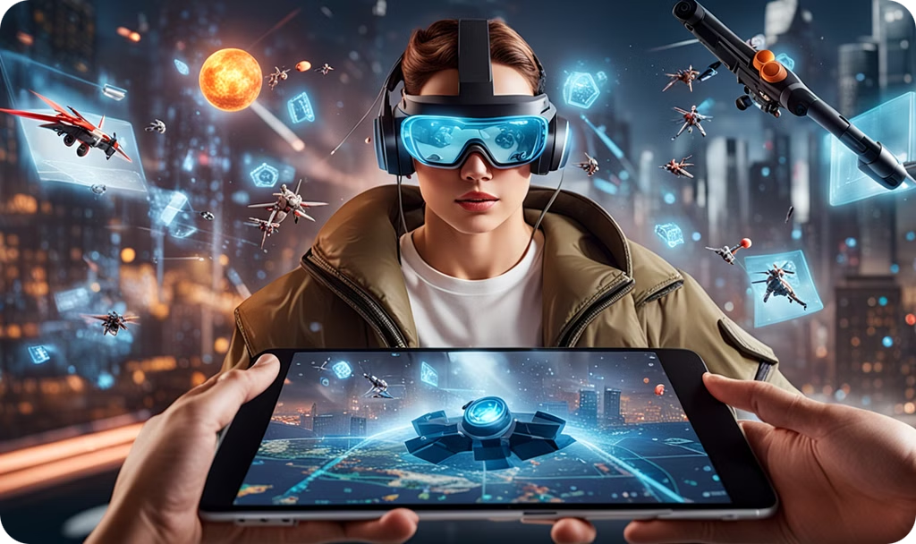
Driving Engagement and Conversion
40%
25%
Increased conversion rates with AR-powered product visualization
Higher average order value for AR-enabled shoppers
75%
95%
Reduction in product returns with AR try-on capabilities
of shoppers say AR makes shopping more engaging and entertaining
Augmented reality unlocks unprecedented engagement and conversion metrics for retailers and e-commerce brands. By empowering shoppers with immersive experiences, AR drives increased conversions, higher average order values, and reduced returns - all while delivering a more entertaining and satisfying shopping journey.

Slide 10

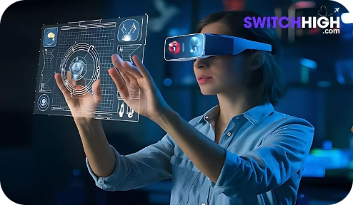




Bridging the Physical-Digital Divide
Visualize Real Products
Enhance Online Shopping
Blend Physical and Digital
Connect the Real and Virtual
AR allows shoppers to see how physical products will look and fit in their real-world environment before purchasing.
AR-powered virtual try-on and product visualization features bridge the gap between online and in-store experiences.
Innovative AR installations in physical retail spaces seamlessly integrate digital content and interactivity.
Augmented reality unites consumer data and behaviors across both physical and digital touchpoints.

Slide 11

Insights and Data-Driven Decisions
78%
65%
of retailers report increased sales with AR-powered experiences
of consumers say AR makes them more confident in their purchase decisions
92%
85%
of shoppers want more retailers to offer AR visualization tools
of brands plan to increase their AR marketing budgets in the next 2 years
Data-driven insights demonstrate the powerful impact of augmented reality on retail and e-commerce. From boosting sales and conversion rates to driving customer engagement and loyalty, AR provides retailers with a clear competitive advantage backed by measurable results.

